Slide 1
Automating Product Displacement in Film
Addison Phelps

Slide 2
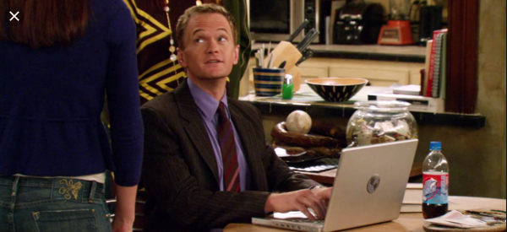

Motivation
The problem: Undesired Product Placement

Slide 3
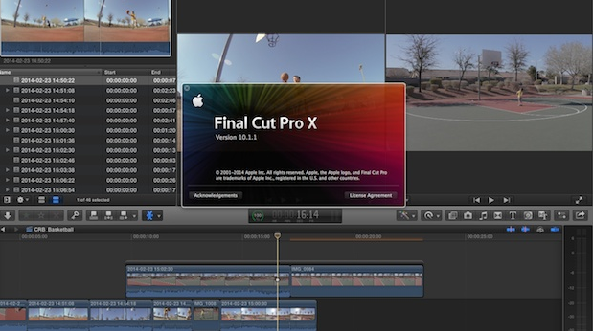

Motivation Cont.
Current Solutions: expensive video editing software or elaborate covers

Slide 4


Proposal
Using fast object detection and powerful image classifiers, bounding boxes of determined logos can be found and blurred.

